Slide 1
#SkillsForLife

Slide 2

Do more.
Be more.
Young Leaders’ Scheme
Scouts.org.uk
#SkillsForLife
Notes:
If you need to change the background please follow these instructions:
1. On your Windows tablet, tap the Design tab.
2. On your Windows phone, open the slide for editing (either by double-tapping it or by tapping it and then tapping Edit). Tap More at the bottom of your screen, tap Home, and then tap Design.
3. Tap Format Background.
4. You will see the background colours divided into Theme Colours and Standard Colours. Theme colours coordinate with the theme you selected previously. You can select a solid colour or colour gradient.

Slide 3
Do more. Be more
Do more.
Be more.
Welcome
Instructor Vincent Burgess
Young Leaders’ Scheme

Slide 4
By the end of this session, you'll:
1. Ensure ESYLs are appropriately supported and integrated into section leadership teams
Leaders will understand their role in welcoming, guiding and regularly checking in with ESYLs, ensuring they feel valued and included within the team.
2. Enable ESYLs to complete required training and missions effectively
Leaders will be equipped to support ESYLs with Module A (within three months) and understand how to guide them through the four missions, including feedback and validation.
3. Promote safe and appropriate safeguarding and welfare practices for ESYLs
Leaders will understand their responsibility for ESYL welfare, Yellow Card expectations, communication boundaries, and safe arrangements on camps and residentials.
4. Strengthen programme quality through effective use of ESYL skills and contributions
Leaders will recognise how ESYLs can contribute to planning, delivering activities, and shaping Youth Shaped programmes, improving the variety and quality of section delivery.
Notes:
Task: approx. 20minutes
1. Choose one person to play the role of the seeker, who is blindfolded, and one to play the role of the instructor. Have the rest of the group line up at the end of the room.
2. The instructor should stand in the middle of the room facing them. The instructor is not allowed to turn around.
3. The seeker stands with their back to the instructor and the rest of the group in the top half of the room.
4. Place a treasure object somewhere in the seeker’s area of the room. Everyone other than the instructor and seeker should see where it's located.
5. The rules of the game are:
- the instructor can speak but cannot use gestures or see where the treasure is hidden
- the rest of the group can see where the treasure is hidden but cannot speak
- the seeker can neither see the treasure nor speak
6. The aim of the game is to get the seeker to find the treasure. The group should use gestures so the instructor can tell the seeker where to go (i.e. left, right, back or forward).
7. Follow the seeker to make sure they stay safe throughout the game.
8. After the game, ask the Explorer Scout Young Leaders to feedback on what was difficult about the task for each of the roles. How did body language/gestures affect the game? Why are clear instructions important?
.

Slide 5
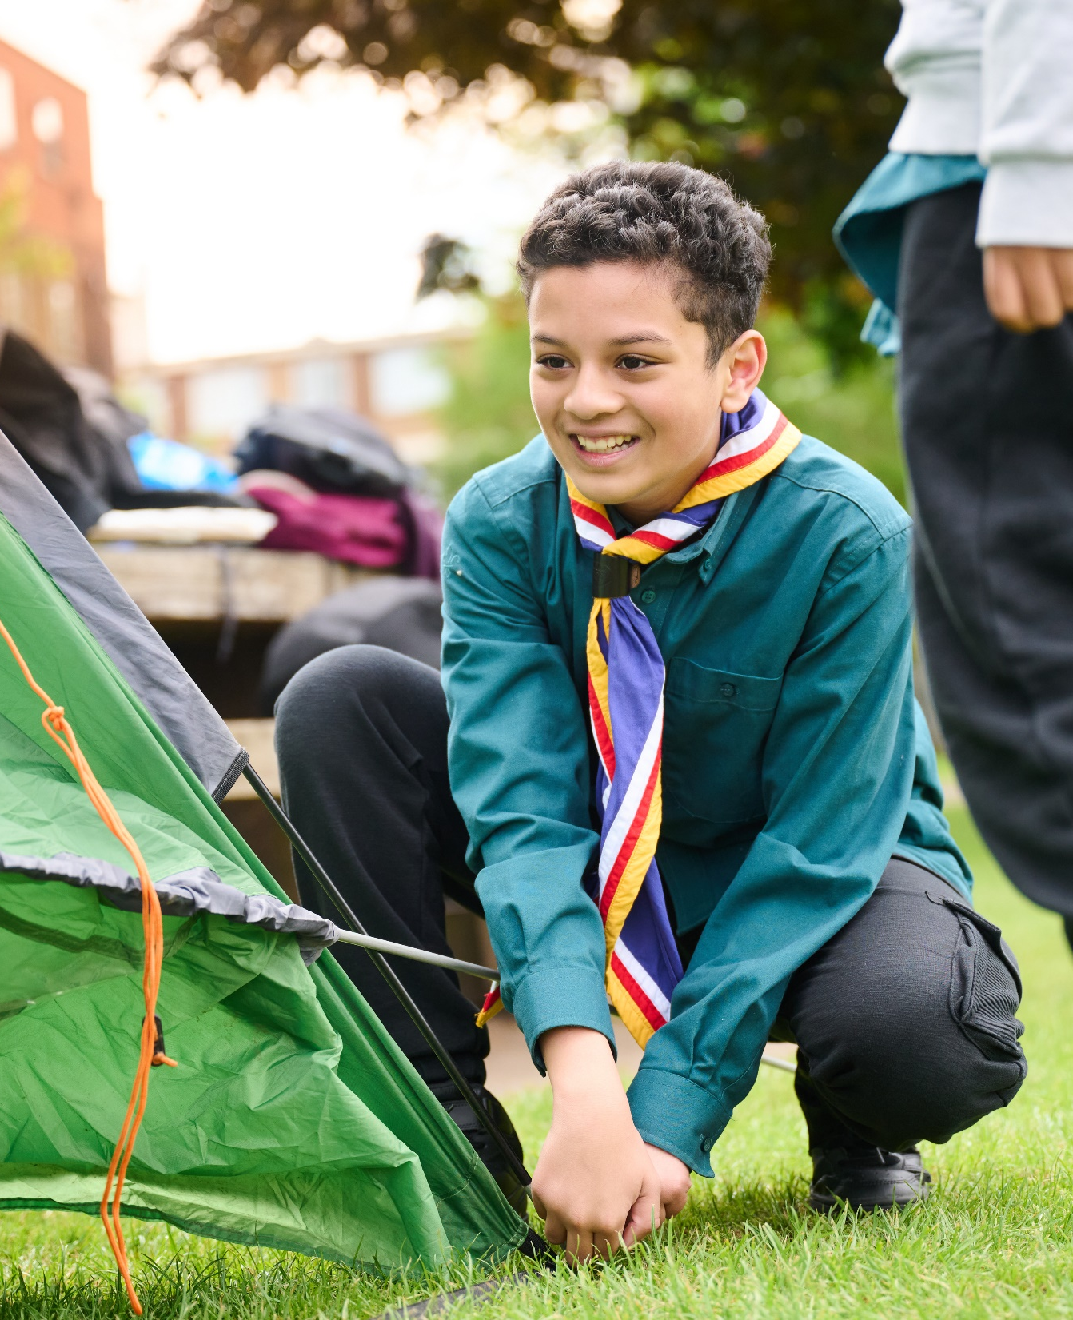
The Young Leader Scheme
How the Scheme
Works
The Explorer Scout Young Leaders’ Scheme (ESYLS) is the learning programme for Young Leaders.
It contains 11 modules and 4 missions for them to work through whilst volunteering in their chosen section.
As well as developing valuable life skills, the scheme is an opportunity for Explorers to make a positive impact in their communities and to fulfil the service elements of many of the Top Awards in Scouts, or their Duke of Edinburgh's Award. Recognition of achievement is available along the way, and on completion of the Scheme.

Slide 6
Do more. Be more
The Young Leader Modules
The modules are designed to be flexible and encourage innovation, so be as creative as you can! As long as the aim and objectives are met, they can be delivered in any way by anybody with the appropriate skills or experience.
Module A - Prepare for take-off (essentials and expectations)
Module B - Taking the lead
Module C - That's the way to do it!
Module D - Understanding behaviour
Module E - Game on!
Module F - Making Scouting accessible and inclusive
Module G - What is a high quality programme?
Module H - Programme planning
Module I - What did they say?
Module J - Communicate it!
Module K - First aid masterclass
Note: ESYLs and Young Leaders volunteering from outside of Scouts must complete module A within 3 months.
Young Leaders’ Scheme

Slide 7
Group Lead Volunteer support
An ESYL offers a great opportunity for a section. They bring a range of different skills and experiences with them, and can support with the planning and running of a section. This not only benefits the section, but allows the ESYL to develop their skills for later life, equipping them for successful careers and to take on adult roles in Scouting.
As the Group Lead Volunteer, you have an important part to play in supporting ESYLs within the sections in your Group. After all, an ESYL is part of a section’s leadership team.
Notes:
Task: approx. 20minutes
1. Choose one person to play the role of the seeker, who is blindfolded, and one to play the role of the instructor. Have the rest of the group line up at the end of the room.
2. The instructor should stand in the middle of the room facing them. The instructor is not allowed to turn around.
3. The seeker stands with their back to the instructor and the rest of the group in the top half of the room.
4. Place a treasure object somewhere in the seeker’s area of the room. Everyone other than the instructor and seeker should see where it's located.
5. The rules of the game are:
- the instructor can speak but cannot use gestures or see where the treasure is hidden
- the rest of the group can see where the treasure is hidden but cannot speak
- the seeker can neither see the treasure nor speak
6. The aim of the game is to get the seeker to find the treasure. The group should use gestures so the instructor can tell the seeker where to go (i.e. left, right, back or forward).
7. Follow the seeker to make sure they stay safe throughout the game.
8. After the game, ask the Explorer Scout Young Leaders to feedback on what was difficult about the task for each of the roles. How did body language/gestures affect the game? Why are clear instructions important?
.

Slide 8
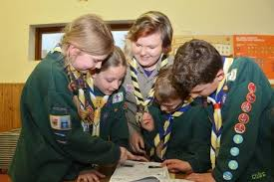
The Young Leader Scheme
How to support ESYLs
as a GLV
Know the amount of ESYLs currently active within your Group, and have an overview of who they are. This will help you ensure they are best supported, and will also help when filling in a census. Introduce yourself when visiting sections to make sure they know who you are. If they have any issues in the section, they may come to you or members of the District 14-24 Team. Similarly, it’s important to know who is looking after the scheme in your District and maintain a relationship with them.

Slide 9
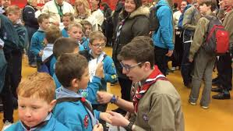
The Young Leader Scheme
How to support ESYLs
as a GLV
Make sure ESYLs feel supported in the section they support. It's important that section team leaders are aware of the benefits having an ESYL on board can bring. As a part of the leadership team, they can be involved with running activities and games, help with Youth Shaped programme planning, and get involved in camps. ESYLs will also input fresh and inspiring new ideas, which will benefit the programme. Check in with section team leaders to find out how ESYLs are getting on.
Make sure all ESYLs have completed Module A within three months and encourage this process. It's important ESYLs are equipped to respond appropriately should a situation arise, protecting themselves and the young person.

Slide 10
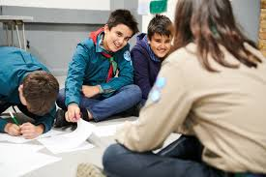
The Young Leader Scheme
How to support ESYLs
as a GLV
Ensure section team leaders are aware of the 4 missions. ESYLs should carry out these missions in the section, and may need support to enable them to achieve their goals.
Promote the wider Explorer Scout provision to the ESYLs in the Group and encourage them to complete their top awards.
Working alongside an Explorer Scout Young Leader (ESYL) opens up many great opportunities for a section. ESYLs can bring a range of different skills and experience to the section they support and can help invaluably with the planning and running of your section. This not only benefits your section but allows the ESYL to develop skills for later life, equipping them for successful careers, and to take on adult roles within Scouting. As a section team leader, the support you offer your ESYL will contribute towards their development and ensure that the section gets the most out of their time.

Slide 11
Your obligations
While an ESYL is working within a section, the section team leader is responsible for their safety and welfare. It's important to remember that an ESYL is still a young person, regardless of their responsibilities. The same Young People First (Yellow Card) guidance you apply to your section should also be applied to ESYLs. You should never spend time one-on-one with an ESYL, and should never directly text or email them without copying in other members of the leadership team, for example.
Camps and residential trips
When the ESYL takes part in a camp or residential, consideration should also be given to the sleeping arrangements. The ESYL should have their own separate accommodation. They should not share with adult leaders, or with the young people in the section.
Notes:
Task: approx. 20minutes
1. Choose one person to play the role of the seeker, who is blindfolded, and one to play the role of the instructor. Have the rest of the group line up at the end of the room.
2. The instructor should stand in the middle of the room facing them. The instructor is not allowed to turn around.
3. The seeker stands with their back to the instructor and the rest of the group in the top half of the room.
4. Place a treasure object somewhere in the seeker’s area of the room. Everyone other than the instructor and seeker should see where it's located.
5. The rules of the game are:
- the instructor can speak but cannot use gestures or see where the treasure is hidden
- the rest of the group can see where the treasure is hidden but cannot speak
- the seeker can neither see the treasure nor speak
6. The aim of the game is to get the seeker to find the treasure. The group should use gestures so the instructor can tell the seeker where to go (i.e. left, right, back or forward).
7. Follow the seeker to make sure they stay safe throughout the game.
8. After the game, ask the Explorer Scout Young Leaders to feedback on what was difficult about the task for each of the roles. How did body language/gestures affect the game? Why are clear instructions important?
.

Slide 12
Do more. Be more
What do your Young Leaders Do?
10mins
Young Leaders’ Scheme

Slide 13
Do more. Be more
The Young Leader Missions
As part of the Scheme, ESYLs will need to complete 4 missions. They should carry out these missions in the section and will need your support to achieve these.
After completing a mission, the ESYL may ask you to complete a short statement or make a comment on how they got on. You can log this in their ESYL Logbook. Feedback will help them to evaluate what went well and what they wish to focus on developing further.
The four missions are designed to allow the Young Leaders to put the learning from the modules into practice. By doing so, they will gain confidence and become an integral part of the leadership team within their Section and Group.
Completing a mission is similar to completing validation of adult volunteer learning. It's important that section team leaders are aware of any upcoming missions, what they entail, and the ways in which they can support the ESYL in their section to complete them.
Young Leaders’ Scheme

Slide 14
Mission 1: Game
Plan and run a minimum of three games with the section you are volunteering with. At least one game should take place indoors and one outdoors.
The games should be varied, incorporating:
at least two different types of leadership style (Modules B and C).
three different types of games; for example some games may be more energetic and active, while others may be more creative or reflective (Module E).
To complete this mission, you could:
run a game at the beginning or end of a section night,
run a wide game on a camp,
run a game that ties into a badge the section is working towards, or
run a game that reinforces something the section has learned
any other ideas, subject to agreement with your District 14-24 Team and Section Team Leader.
Notes:
Task: approx. 20minutes
1. Choose one person to play the role of the seeker, who is blindfolded, and one to play the role of the instructor. Have the rest of the group line up at the end of the room.
2. The instructor should stand in the middle of the room facing them. The instructor is not allowed to turn around.
3. The seeker stands with their back to the instructor and the rest of the group in the top half of the room.
4. Place a treasure object somewhere in the seeker’s area of the room. Everyone other than the instructor and seeker should see where it's located.
5. The rules of the game are:
- the instructor can speak but cannot use gestures or see where the treasure is hidden
- the rest of the group can see where the treasure is hidden but cannot speak
- the seeker can neither see the treasure nor speak
6. The aim of the game is to get the seeker to find the treasure. The group should use gestures so the instructor can tell the seeker where to go (i.e. left, right, back or forward).
7. Follow the seeker to make sure they stay safe throughout the game.
8. After the game, ask the Explorer Scout Young Leaders to feedback on what was difficult about the task for each of the roles. How did body language/gestures affect the game? Why are clear instructions important?
.

Slide 15
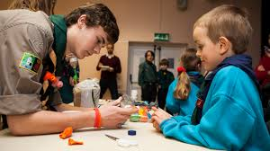
The Young Leader Scheme
Mission 2: Activity
Plan and run an activity (not a game) with the section you are volunteering with.
The activities should include:
planning and organisation,
delivery, and
gathering any equipment or materials needed.
To complete this mission, you could:
choose an activity badge to run as part of the programme, providing all of the information and materials required for the section to achieve this.
run a segment of the camp programme, such as a pioneering activity or obstacle course, planning the route for a hike, initiating some team challenges, or organising and leading a campfire.
record the ways in which your section’s programme activities could count towards different badges and awards.
run an activity for the section, relating to one of your own hobbies or interests.
any other ideas, subject to agreement with your District 14-24 Team and Section Team Leader.

Slide 16
Do more. Be more
Mission 3: Programme planning
Take the section’s programme ideas to a programme planning meeting.
This mission should include:
asking the young people in the section to contribute their ideas to the programme.
capturing the ideas and suggestions from the young people and exploring how these could be incorporated into their programme.
attending and contributing to a meeting (eg programme planning meeting, leaders’ meeting, District, County/ Region or Area meeting).
To complete this mission, you could:
attend a section planning meeting.
plan and run a meeting (eg section planning forum or running activities from the YouShape resources).
decide who should attend a meeting and invite them along.
organise and run a forum for the young people in your section, gathering their ideas and suggestions, and feeding these back to the section team leader.
organise for someone to take notes, minutes or points of action.
plan and run the Sixers’ or Patrol Leaders’ forum, ensuring that the young people in the section understand how they can input their ideas into the section programme.
any other ideas, subject to agreement with your District 14-24 Team and Section Team Leader.

Slide 17
Mission 4: Delivery
Take responsibility for organising and running part of the section programme.
This mission should include:
planning and organising a selection of activities on a theme,
delivery of those activities, and
evaluation and review of the activities with the section.
To complete this mission, you could:
plan and run a linking event with either the section above or the section below, working with the leaders of the sections above and below to arrange everything.
plan an event, night or activity, ensuring it is appropriate for the age range of the young people, and is well-suited to the venue.
include members of the section in the running of an evening.
plan and run a Challenge Award with the young people, ideally choosing one that either has not already been achieved by anyone in the section, or which has been achieved by the fewest members.
plan the monthly, termly or yearly programme of activities needed to achieve the award.
plan a camp for the section (under the supervision of a leader with a Nights Away Permit).
help the young people in the section to explore a particular topic, or to develop some specific skills.
any other ideas, subject to agreement with your District 14-24 Team and Section Team Leader.
Notes:
Task: approx. 20minutes
1. Choose one person to play the role of the seeker, who is blindfolded, and one to play the role of the instructor. Have the rest of the group line up at the end of the room.
2. The instructor should stand in the middle of the room facing them. The instructor is not allowed to turn around.
3. The seeker stands with their back to the instructor and the rest of the group in the top half of the room.
4. Place a treasure object somewhere in the seeker’s area of the room. Everyone other than the instructor and seeker should see where it's located.
5. The rules of the game are:
- the instructor can speak but cannot use gestures or see where the treasure is hidden
- the rest of the group can see where the treasure is hidden but cannot speak
- the seeker can neither see the treasure nor speak
6. The aim of the game is to get the seeker to find the treasure. The group should use gestures so the instructor can tell the seeker where to go (i.e. left, right, back or forward).
7. Follow the seeker to make sure they stay safe throughout the game.
8. After the game, ask the Explorer Scout Young Leaders to feedback on what was difficult about the task for each of the roles. How did body language/gestures affect the game? Why are clear instructions important?
.

Slide 18
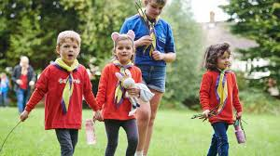
The Young Leader Scheme
Young Leader
Logbook
As the ESYL completes their missions there will need to be evidence completed in their logbook.
This should be done by the section leader that has witnessed the mission being completed.
There are some copies about for you to have a look at.

Slide 19
Do more. Be more
Any Questions?
Young Leaders’ Scheme

Slide 20
Thank you

