Slide 1
#SkillsForLife

Slide 2


Do more.
Share more.
Be more.
Lucy Jewell,
County Youth Lead

Slide 3
Objectives:
To understand what youth shaped Scouting is.
To recognise what my role is, in supporting youth shaped Scouting.
To identify some of the barriers in delivering high quality youth shaped Scouting.
To know where to access further information and support.

Slide 4

What happened that influenced you in your early life? What was important to you?

Slide 5
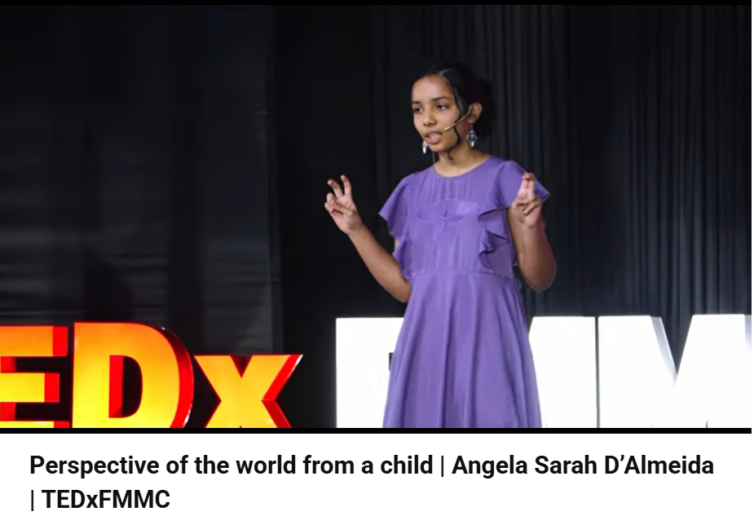
Perspective of the world from a child | Angela Sarah D’Almeida | TEDxFMMC
Watch until 3 mins

Slide 6

So, what is youth shaped Scouting, over to you!

Slide 7
It's nothing new- DON'T PANIC!
Young people and volunteers working together to shape, influence and lead
Forms a major part of our current Skills for Life strategy and will be key in the next one
A powerful skill to carry in life

Slide 8
In Scouts, youth shaped is about:
Creating an environment where young people can take chances and learn from their mistakes.
Empowering young people to stand up for what they believe in and lead their peers.
Putting young people first and giving them the chance to work with their leaders to make a difference in their group, their community, and the wider world.

Slide 9
Why is being youth shaped important?

Slide 10
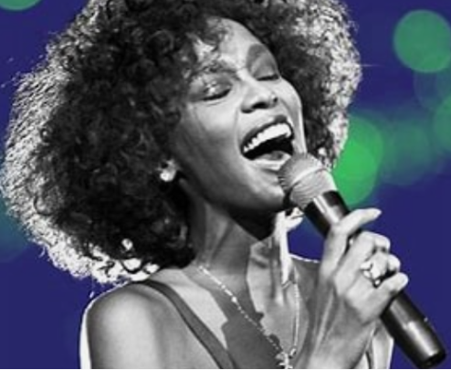
Why is being youth shaped important?
Volunteers are in a unique position
The UN’s first priority for their Youth 2030 plan is to ‘Amplify youth voices for the promotion of a peaceful, just and sustainable world’.
Young people are the future of the world- THINK WHITNEY!

Slide 11

In Summary:
Poor Quality = Boredom = No YP = NO Scouts
Programme

Slide 12
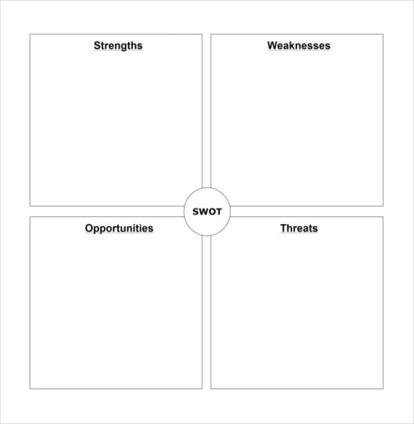
Young Leaders are not present in any/every section
Young people enjoy coming to Scouts
Section forums are held regularly and youth voice is actioned
Leaders have a pre-written rolling programme
Try something new
Leaders are stuck in their ways
Young People are full of ideas
The classic 'Children should be seen and not heard'
External factors from young people

Slide 13
Over to you, where do you think your group/district is currently at in terms of being youth shaped?

Slide 14
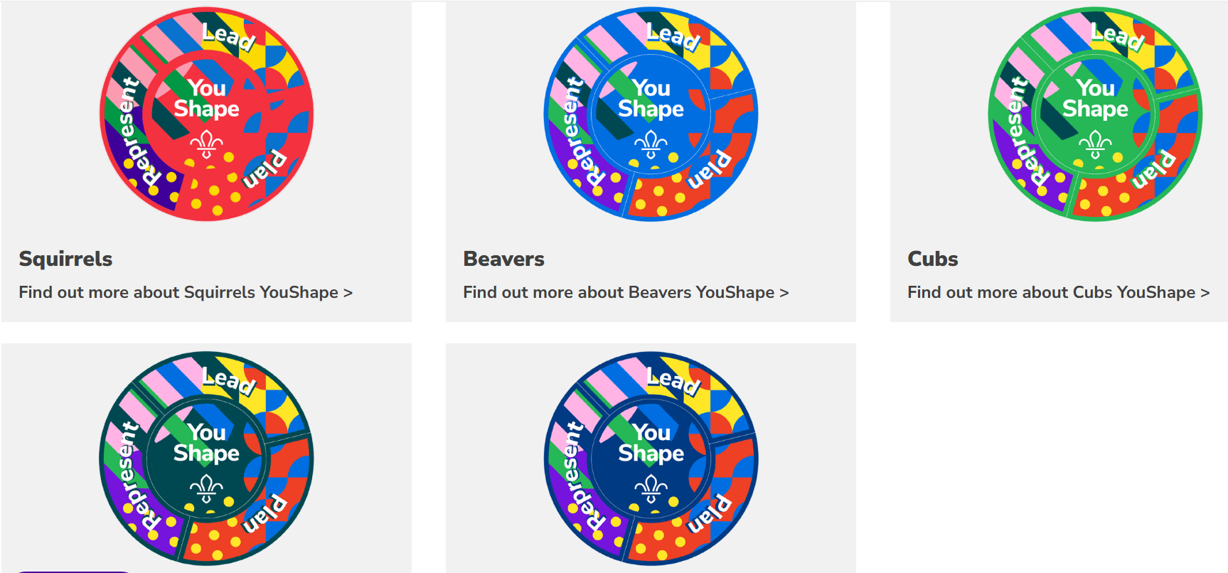
Not a bolt on! Don't have a youth shaped evening! Woven throughout

Slide 15
Thank you

