Slide 1
Recruiting and Retaining Volunteers
Lou Ousley
Notes:
Welcome - 1 mins, 1 mins total
Key points:
Introduce yourself
This is a workshop and not a presentation
It is interactive
Ask questions whenever you want
Add ideas to conversations we are having
The more they put into it the more they'll get out of it

Slide 2

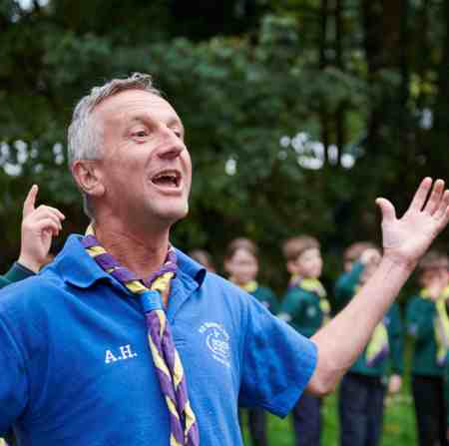
Why did you start volunteering?
Motivations
Notes:
Why do you volunteer? – 1 mins, 2 mins total
Key points:
By working out what motivates people to volunteer will maximise the chance you have of reaching someone.
Who best to ask why volunteer than people that already volunteer.
Scout Experience Survey answers

Slide 3
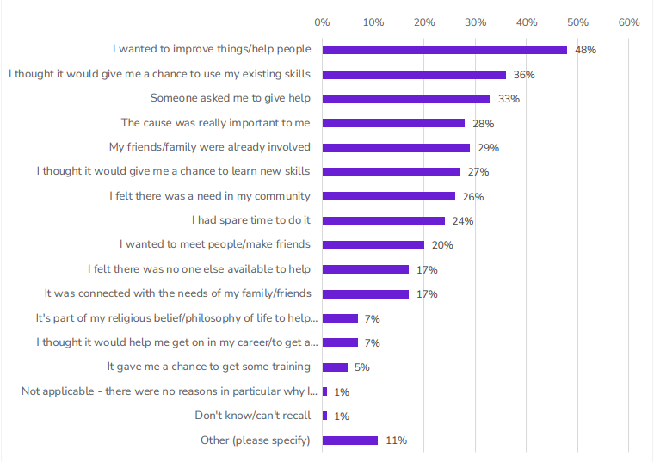
Adult Volunteer Motivations for Joining Scouts
Scout Experience Survey 2022
Sample size – 7682 volunteers
Notes:
Motivations 2 - 3 mins, 5 mins total
Key points:
Reveal answers – did they match the participants' expectations
Pick out some of the motivations and discuss
e.g. 33% of people started because "Someone asked me to give help"
e.g. 36% of people started because "I thought it would give me a chance to use my existing skills"

Slide 4

What barriers do you
face when looking for
new volunteers?
Notes:
Barriers to finding new volunteers – 7 mins, 12 mins total
Key points:
There are many barriers that can be faced when recruiting new volunteers, we want to identify them and work out how to break them down.
Activity – Barrier Wall (5mins) :
Hand out "bricks" with barriers written on
Participants bring an item to the front and attach to build up a wall (attach to a wall, back of vacancy board or another surface)
When they bring it up, discuss as a group what the barrier is and how it could be overcome
Ask if anyone can think of any others – write them on blank bricks and attach to wall
(Leave the wall in place as it will be used later)
Just saying ‘we want to recruit’ isn’t enough.
We need to make sure we know the reasons behind our need to recruit and why we might struggle so that we can put any issues right.
We need to make sure we’re being attractive to new people, that we’re understanding why a positive Group culture is so important and recognising what motivates new volunteers to stick around.
Only once you’ve addressed all of these points will a recruitment campaign actually work.
Some examples of barriers:
Group isn't visible, no signs etc – people don’t know you exist
Venue not appealing
Not having the right people in the right roles
Not being smiley and friendly when new people arrive
Negative conversations / ‘moaning’ for want of a better phase to or in front of potential new volunteers
No team spirit
Negative atmosphere within the group
Only one person thinks about welcoming and recruitment
Not asking – people might not know your short of adults, and if you don’t ask you don’t get
Not making assumptions about people – what could they give?
Cliques
All male/female leadership teams
Overloading people with information about training straight away
Fear of legal responsibility

Slide 5
What needs doing?
Review
What tasks?
Enquiries?
Reviews?
Team meetings?
Who are you looking for?
Ongoing Recruitment
(Vacancy Board, Adult Rota, engagement events)
What skills/interests?
Support them
Buddy?
Check ins?
Resources?
Get people through the door
Find them a place
Be
prepared
Place in the team?
First impressions?
Welcome?
Making Noise?
The ask?
Notes:
Being Prepared - 10 mins, 22 mins total
Key points:
Recruitment should be an ongoing process
The Recruitment Cycle is a way of visualising what steps need to be taken for successful recruitment
Talk through the Recruitment Cycle steps
What needs doing?
Work out what tasks need doing in your Group
Who are you looking for?
Identify the skills and qualities someone would need to do each task
Get people through the door
Advertise, run open events, talk to adults, use our toolkit to attract as many people as possible
Be brave and ask potential volunteers what tasks they could take on
Find them a place
Fit them into your Group in a team they want to be in doing tasks they’re happy doing
Make a good first impression and welcome them into your Group
Support them
Link your new volunteer with a buddy, check in with them regularly and give them everything they could need to enjoy their Scouting
Review
Reflect on the recruitment cycle, talk to your new volunteers, work out what you did well and what needs improving, decide on what else you need and continue the cycle
Ongoing recruitment
Recruitment should be a part of the everyday without an end point
Use vacancy boards, set up an adult rota and run regular events so that parents and adults can join in the fun
The cycle should be reviewed regularly (termly or yearly) to be successful
Key points:
Not having a plan in place could mean we could recruit lots of new volunteers but still fail at retaining them.
Having a plan and an outcome in mind will aid us in our process and improve first impressions of any new volunteer. If we can't get this part right, what does that say about us?
Using the recruitment as an example, what things do we need to think about before we start recruiting?
Go through their answers and add any of the following:
What tasks do you need filling in your Group?
Do you know what skills you need from new volunteers?
How, when and who will respond to enquiries?
What do you want to know from a new volunteer?
Their interests and hobbies?
Their profession?
Whether they want to work with Young People?
What evenings they are available?
Do you have the right details on joining forms/online?
Are you getting enquiries from HQ?
Do you have a welcome pack in place?​
Is just putting an advert up in the newsletter enough?
Who is going to proof read and check adverts are correct?
Do you have the resource to support new volunteers?
Is your Group atmosphere welcoming?
Identify a 'buddy' or mentor for new volunteers
Where do volunteering enquiries come from about who will deal with them? (can you take enquiries by email, social media, in person, or a phone call)
Signpost to the ready to recruit self assessment - Ready to recruit | Scouts
When thinking about recruitment, it's important that we also think about inclusivity and diversity
We shouldn't just be recruiting people who look, sound or act like us, we should be reflecting the diversity of the area we live in
Diversity extends beyond race – sex, gender, sexuality, and physical, mental or emotional ability
There is always diversity in every community, think about local shops, takeaways, religious buildings or groups. Are you reflective of your community?

Slide 6


Tools for Recruitment
  Growing Scouts Resources
  Rule of 7!
Notes:
Tools for recruitment - 1mins, 23 mins total
Now, we've talked about why you might need to recruit and how working as teams will help us, but the next question is, how do we actually do it?
The good news is the Growing Scouts webpages have lots of resources to help you with all aspects of recruitment, from getting more volunteers involved, to saying thank you, or setting up a new section or Group entirely.
So, let's go through them in more detail to show you how they can work
But before we do that, it’s important to highlight the rule of 7..... this is something that is used in marketing and sales. The marketing rule of 7 is an old marketing principle stating that a prospective customer needs to see or hear a brand's message at least seven times before they are likely to take action, such as making a purchase. This concept is based on the idea that repetition builds familiarity, which in turn builds trust and confidence. While the exact number may vary, the rule highlights the importance of consistent and persistent marketing across multiple touchpoints to be memorable in a crowded marketplace. So that could 7 times to introduce scouting to someone, let alone for volunteering.....

Slide 7


Recruitment Toolkit
Ready-made ideas to recruit young people & volunteers including:
  Open events
  Four Week Challenge
  Rotas and surveys
  Name generation
  Working with local businesses
  Making the most of family camps
  Group get-togethers
  Working with schools
Notes:
Recruitment Toolkit – 5 mins, 28 mins total
Firstly, the recruitment toolkit has ideas and practical solutions to help attract more volunteers.
We know that open events are a brilliant recruitment tool for attracting young people and adults. For a new Squirrel Drey especially, the leadership team will be made up almost entirely of parents, so an open event is a great way of getting the volunteers through the door. A great open event involves lots of tabletop activities that adults and their children can take part in together, so everyone is having fun and getting stuck in. The ultimate aim from it is to show the adults that volunteers have as much fun doing the activities as the young people do, so why not get involved! At an open event, you can try to get adults signed up for the Four Week Challenge.
The Four Week Challenge is a gradual introduction to Scouts for potential volunteers. They agree to help out for just four weeks, while a more experienced volunteer shows them the ropes and helps them get involved. Try promoting the four-week challenge when you're recruiting new volunteers or even to your current parents and carers as well. The Four Week Challenge works because it’s manageable: people feel more comfortable signing up for a short amount of time. As an existing volunteer, at the very least you get four weeks of an extra pair of hands, and you have the chance to help them settle in, grow in confidence, and see just how much they can get from Scouts.
We also have adult rotas – Many Groups use adult rotas with their parents and carers, asking them to sign up when their young person joins the section. Make it clear to the parents and guardians of your young people that their support in volunteering for sessions will be needed. Set up an expectation of a regular commitment, this might only be signing up once a term but will provide you with extra helpers. They're key to making the most of an adult rota is to keep them busy! For each of these sessions make sure there are tasks already set out for the adults to do. It's a great way of making sure you have a spare pair of hands for each session, and also helps parents and carers appreciate that Scouts is run by volunteers. It also means they get to experience the fun of supporting the section and will increase the chance of them becoming more regular volunteers.
Send out an adult survey as well, find out what their interests, hobbies and even professions are, they WILL surprise you with the skills they have that could help you in carrying out your programme by running a specific session.
When we’re looking for someone to take on a more specific role within Scouts – like Treasurer or Group Lead Volunteer – we might find it difficult to know who to ask. But these roles require specific skills, so creating a list of names of people who may have those skills can help you find the right person for the task. That is why we advise running a name generation exercise.
The idea behind name generation exercises is to get a group of people together to write a list of names of people who could be good at taking on that role. It can be useful to invite people from outside Scouts to participate, making it clear that you’re not asking them to commit to a role, but instead just want to pick their brains and explore any contacts they may have or networks they’re aware of. You don't just have to include your current volunteers as well, ask parents and carers, schools, local businesses, even councillors to help out and take part! Most people have never been asked to volunteer and sometimes that's all it takes to get them on board; a name generation exercise can help you identify people and ask them directly, which is a very powerful way of getting someone involved.
In our Recruitment Toolkit, we also have advice on working with businesses. Finding businesses to work and collaborate with can be as easy as looking on Google maps, talking to the parents in your Group and benefitting from the contacts they have in the community. You can hold an open event and specifically invite local businesses and councillors to come along. You can use this to tell them how your Scouts help the community you are all part of and how they can help you! Remember when reaching out though to have a goal of what you want to achieve as this will help who you contact and ask.
Schools are a great resource to use in your local area, they're not just a great way to advertise for recruiting young people (and sometimes volunteers as well!) but they are also a great partner to have, with access to spaces that can be really beneficial for your Group. They are also a great partner for potential fundraising opportunities by taking part in school fairs and just getting Scouts out there more in your community!

Slide 8

Growing
Scouts Resources
Group Operational Support Toolkit
Furthering Reach
National support
Notes:
Further resources on Growing Scouts - 2 mins, 30 mins total
As well as our Recruitment Toolkit, we have plenty of other resources on our growing Scouts webpages for you to use.
We have a Group Operational Support Toolkit that focuses on ways to support the running of your Group, which will help with recruitment.
In the Group Operational Support Toolkit there are pointers for creating a great programme, and social media and communications advice, as well as ideas on how to use family camps as a recruitment tool.
Family camps are a brilliant way for the whole family to give Scouts a go. If you keep adult recruitment in mind from the start, you can use a family camp to encourage parents to volunteer. By getting them and their children involved with cooking, cleaning, and running activities, they're becoming part of the team without realising. A family camp shouldn't be an event that you put on for them, it's an event that you run with them.
If you don’t fancy running a full camp, you could hold a Group get-together, where you invite families in for a day or an evening and get them involved with the activities. If you can put on an adults vs kids olympics, or maybe a bake-off competition, you'll be able to show how much fun it is to be a volunteer and you're able to have fun with a group of new adults!
We've also got guidance here on putting together a Group Development Plan. These are really useful documents that will help you focus on the way forward by drawing information from different places and people. Check if your Group has one and, if not, maybe it's time to check out our pages and put one together.
As well as the Group Operational Support Toolkit, we have lots of information about furthering reach – by that we mean engaging with our communities, especially those we might not have engagaed with before.
Engaging with your community is really important in attracting new young people and adults. It opens the door to starting new relationships and bringing people into your Group to offer that first step into Scouts. We can't promise you'll find a new Team Leader at your first community event, but you might attract a couple of team members who may become your future Team Leaders.
We have advice and resources to help you create a community map and reach out to those you haven't spoken to before. There will be people out there who don't know Scouts exists locally but would be perfect to join your team, we just have to find them.
And has your local community got empty shop windows or community notice boards? Why not use them to promote Scouts! In our handout there is a guide to show you how you can go about using empty shop windows to show your Scout group off.
.

Slide 9
Tools for Recruitment
  Communication
Notes:
Tools for recruitment – ways to communicate - 1 mins, 31 mins total
You won't need to use all of these tools all the time; some are more suited to certain groups of people. Now you’ve heard about them, think about who you are trying to attract – is there a group of people you want to target specifically?
Are you trying to recruit the parents who come along and drop their young people off each week?
Do you have a large university student population local to the group?
Are you looking for business minded people to take on management tasks or join the trustee board?
All of the above?
Knowing your target audience and being able to recruit for a specific task will help you attract the right people for that task. Once you know who you need, you can start thinking about how to do it.
As we’ve have looked at the tools and resources found on the Scout website for recruitment, we are now going to highlight a few other tools that you could use specifically that focus on communicating and advertising to adults.

Slide 10
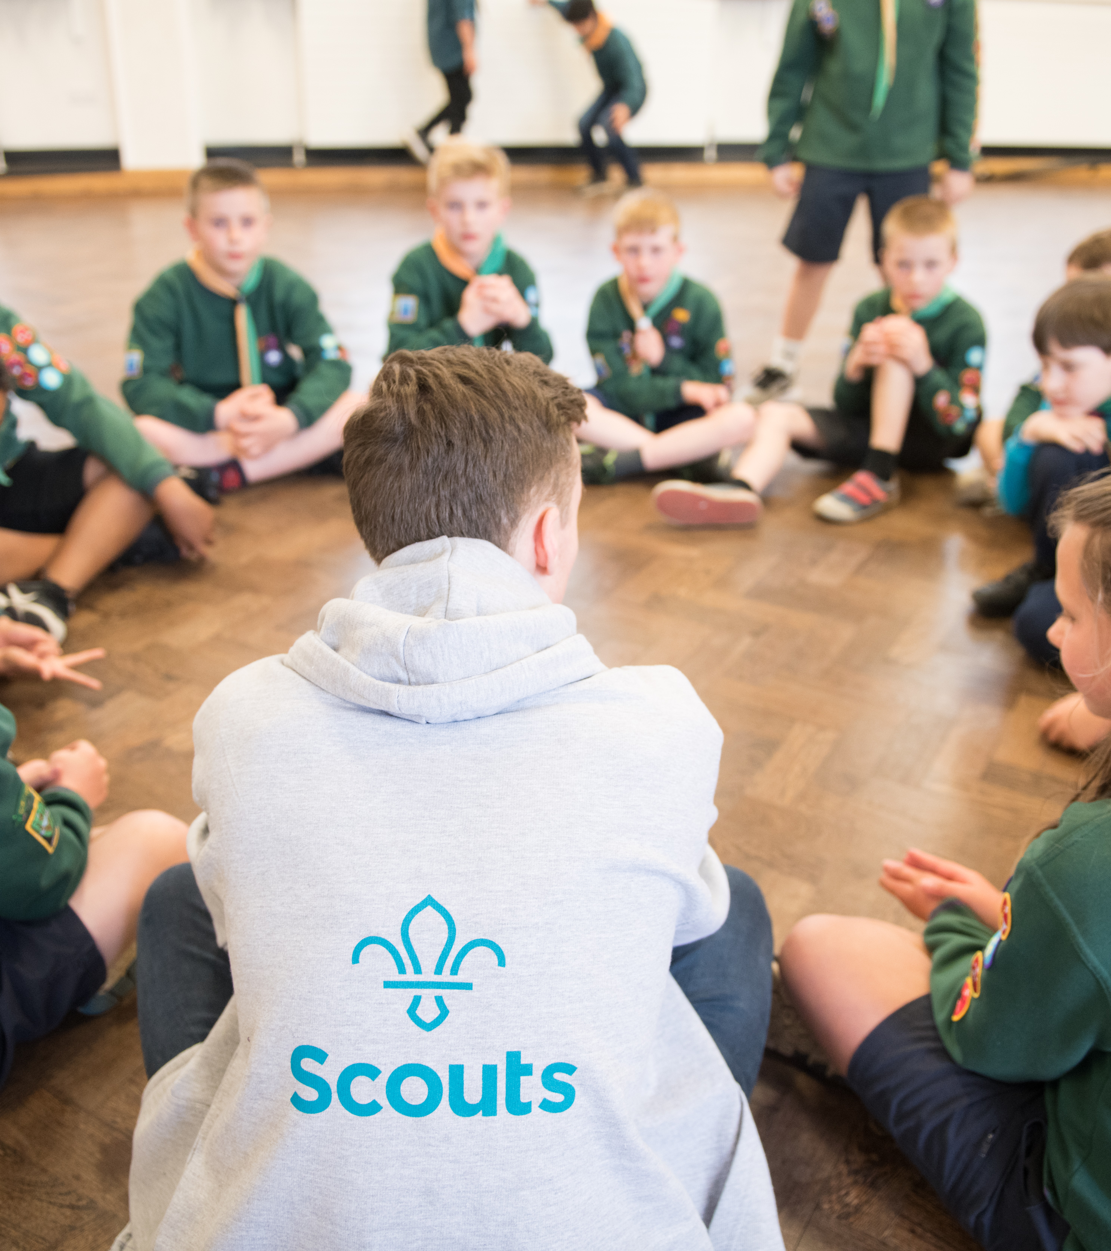
Advertising
Volunteering Opportunities Tool
Volunteering Websites
Flyers, posters and leaflets
Notes:
Ways to advertise – 3 mins, 34 mins total
The best place to start your advertising is by using our Scouts Volunteering Opportunities Tool. It gives you the chance to put up adverts on the Scouts website, so when an adult puts in their postcode and some details about when they're available and what they'd like to do, all the opportunities in their area pop up.
Any Lead Volunteers, Team Leaders and those with the Recruiter accreditation can create and manage the opportunities and enquiries that come back. The more opportunities we can add to the system, the better!
A major benefit of using this tool is that when an adult enquires about an opportunity, their details are automatically put into the membership system, so no more copying details from a form or trying to read someone's handwriting, it's all done in literally one click!
You can also create links to each of your opportunities, meaning you can direct people from elsewhere into our system, keeping all of the enquiries in one place.
For example, there are other volunteering websites out there, like Doit.life, where you can put adverts out to the public. In those adverts, you can put the link to your opportunity on the Scouts website, so you're accessing more people and bringing them into the same system.
It also works well with physical resources, like flyers, posters and leaflets, by using QR codes. We'll have a look in a minute at how you can use the Brand Centre to support your advertising.

Slide 11

Using Social Media
Social Networking & Media Sharing – what’s the difference?
    1. Keep it simple
    2. Follow up promptly
    3. Make it fun
    4. Use the Brand Centre
    5. Post publicly
Notes:
Using Social media – 3 mins, 37 mins total
Let’s talk about social media.
Now, I know—it’s a bit like marmite. Some people love it, some people… not so much. But whether you’re a fan or not, it’s a quick, free, and super effective way to connect with your local community.
Think about it—are there local Facebook groups where people share events or chat about what’s happening nearby? Does your local councillor post updates on X? Could a nearby college or uni share a fun video about Scouts on Instagram?
There are two main ways we use social media:
Social networking – that’s platforms like Facebook, X, and LinkedIn, where it’s all about connecting people.
Media sharing – think Instagram and YouTube, where we focus on visual content.
Scouts can use both to build community and promote what we do. It’s a great way to:
Show off the positive impact we’re having
Share local, engaging content
Get people interacting with us
Spread the word further with shareable posts
You can also use social media to advertise volunteer roles directly from the Scouts website. It’s a brilliant way to reach people who aren’t already involved. Share photos, videos, and good news stories—it’s all about showing the great stuff happening in your Group.
And the best part? No printing costs! It’s cheaper than traditional media, though you can still explore paid ads if you want to boost your reach.
We would definitely recommend creating a public page on Facebook or Instagram so people can find you easily and share your content. And don’t be shy—post in local groups! You’re part of the community, so let people know what you’re up to.
Most importantly—celebrate your wins! Whether it’s a successful event or recruiting a new volunteer, shout about it online.
There’s loads of guidance in the Scouts Social Media Toolkit, which links to other ways to use local media too. You’ll find it in your handout, so have a look and think about what could work best for your Group or Section.

Slide 12
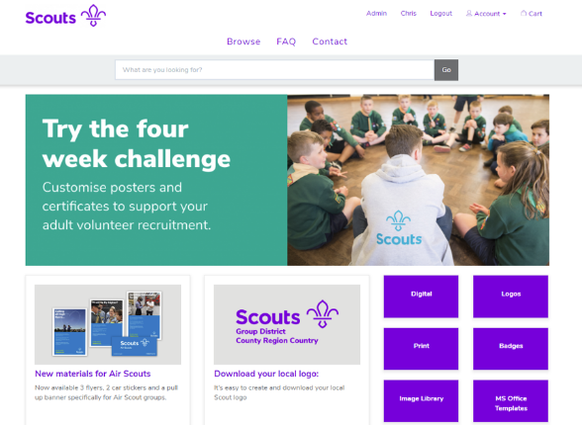

The Brand Centre
Social media templates
Role advertisement templates
Vacancy Boards
Certificates & leaflets
Notes:
The Brand centre – 2 mins, 39 mins total
The brand centre is great to create adverts out for volunteers especially on social media pages and your website, so make sure you take some time to look.
There are so many resources on the Brand Centre to support you with recruitment:
Recruitment posters & flyers
Stationary
Invites and tickets
Signage for your meeting place
Banners
Social media templates
Plus, you can find lots of other fun things on there, like the badge posters and promise posters! There’s more being added all the time!
And remember Vacancy Boards are a great way to get the message out that you are looking for more volunteers to help, which you can order from the Brand Centre. But this doesn’t have to be a physical board. You can create an online vacancy board, use social media or have the traditional board at your HQ which can also be moved around in your community to make it move visible. The more you move it around, the more attractive it will be. Its easy to ignore a vacancy board if it is always in the same corner – so make people take notice!

Slide 13

Making a Recruitment
Plan
Notes:
Introducing recruitment plans
Once you've decided on who you want to recruit, what method you want to use and how to recruit them, having it written in a plan helps create a timeline and makes it clear who is doing what. This is exactly what a recruitment plan is, a written down working document that changes and adapts with each input and action taken by your volunteer team.

Slide 14
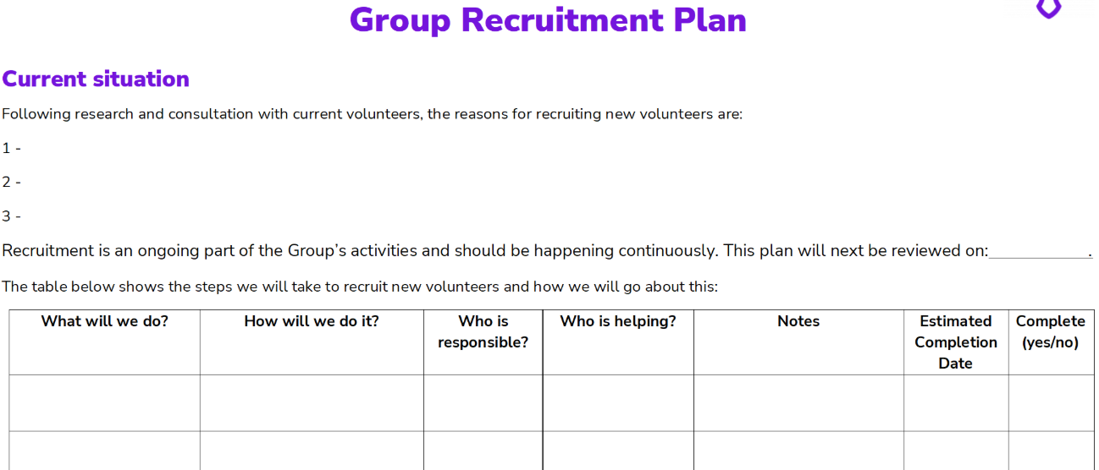
Notes:
Recruitment Plans– 3 mins, 42 mins total
So, let's have a look at the blank plan on screen.
Start by writing a Current Situation. Give a quick overview of your Group and your top three reasons for wanting to recruit more volunteers, so anyone who picks up the plan instantly has a full idea of your situation, as well as being able to refer back to it to make sure that each action works towards solving one of your reasons for wanting to recruit.
This overview could include:
how many young people and adult volunteers you have got currently,
how many have left or a due to be leaving,
what challenges you may have faced in recent times.
why you're actually looking for new volunteers, so you are able to nail down the reasons for needing an extra pair of hands
Use the 'What will we do?' column to create a goal and the 'How will we do it?' column to make it clear what exact actions you'll take to reach that goal. We'll have a look at an example of these in a minute.
You have space as well to allocate your actions to people and some notes if you've already got specifics on what's going to happen.
Adding an 'Estimated Completion Date' will help keep things moving and will help keep you on track, especially if you have some volunteers leaving soon.
Remember to share your plan to all members of the team, even if they don’t have a task, as everyone should be part of recruitment and they might have some ideas on how they can support.

Slide 15
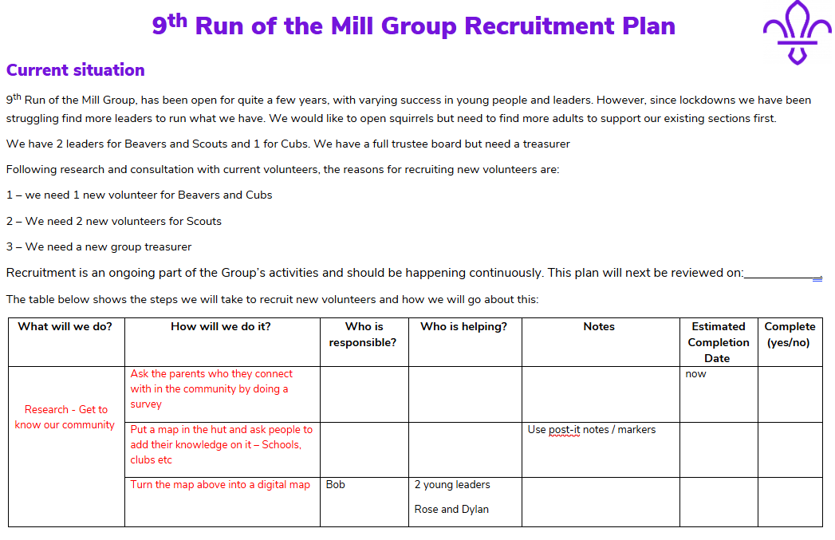
Notes:
Involve your team! – 3 mins, 45 mins total
This example has main priorities are recruiting new section volunteers and finding a new treasurer, so he's written in some top priorities.
Each priority should be broken into SMART tasks—Specific, Measurable, Achievable, Realistic, and Time-bound. This helps:
Share the workload
Encourage ownership
Involve the whole team—leaders, Trustees, parents, and young people
For example, the GLV needs a new Beaver volunteer. They start by asking:
Is someone leaving?
Is the current team overwhelmed?
Is there a waiting list?
Are there any interested adults already?
To gather evidence, they could:
Ask the Scout community and wider networks
Research local demographics
Use questionnaires to see who might be interested
Engage local schools and businesses
Involve Scouts and Young Leaders in outreach and research
Partnering with others, like schools or local charities, can also help.
This approach shows how large goals can be broken into small, actionable steps that are easy to share and manage across the team.
An blank editable version and example completed plan are available on the website

Slide 16

A Good Welcome
First impressions count!!
Notes:
Creating a good welcome - 3 mins, 48 mins total
Key points:
First impressions are really important and could mean the difference between a new volunteer staying or leaving
Do you....?
Meet them before invite to hut
Arrange a phone call to chat through what THEY want to get out of volunteering
Give them detailed directions to get to hut
Introduce them to the other adults in the room (with both scouts name and given name?)
Send them a link to the Welcome to Scouts webpage
Lend them a necker on their first night volunteering....
Give them an adult welcome pack
Buddy them up
There are so many ways to welcome someone.... and this is just the first step on their volunteer journey

Slide 17
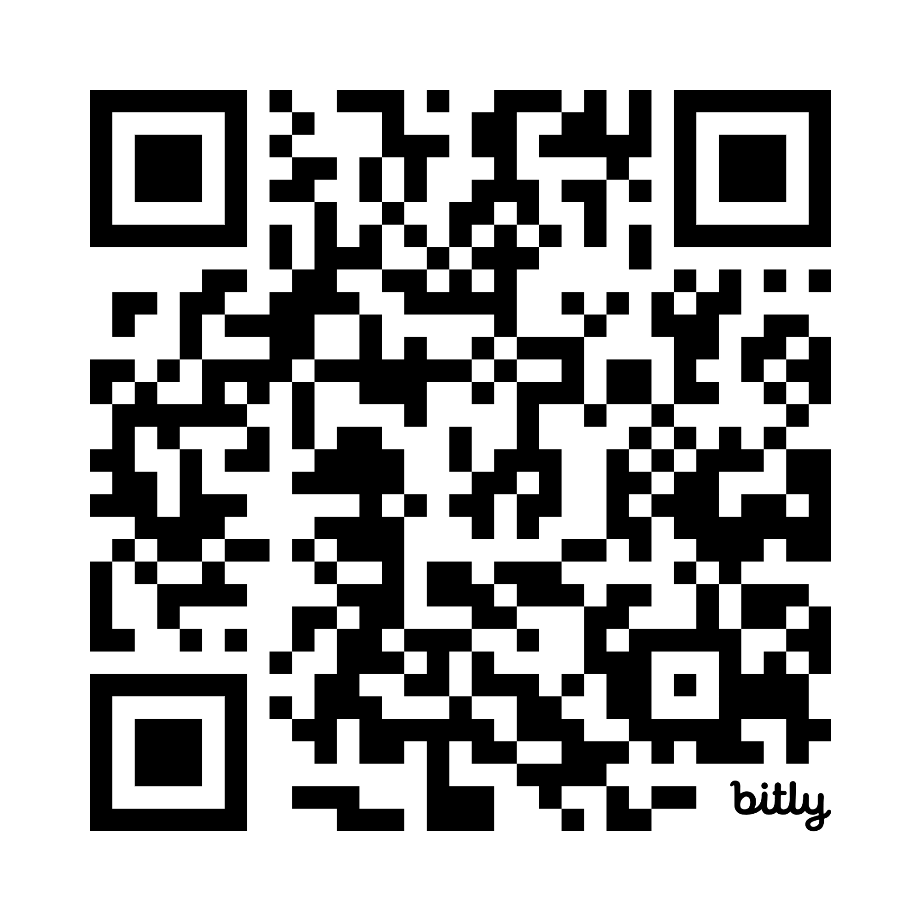
Thank you
&
Q&A

Slide 18
#SkillsForLife

Slide 19


Do more.
Share more.
Be more.

Slide 20
Our values
Integrity
Respect
Belief
Care
Cooperation

Slide 21
Fact 1
Fact 2
Fact 3
Fact 4
#SkillsForLife

