Slide 1
#SkillsForLife

Slide 2


Do more.
Share more.
Be more.
Caroline Jewell
Equity, Diversity and Inclusion
Programme Sponsor for The Scouts

Slide 3
What does E.D.I mean for Scouts in Northamptonshire?

Slide 4
The EDI Programme of Work and the new strategy

Slide 5
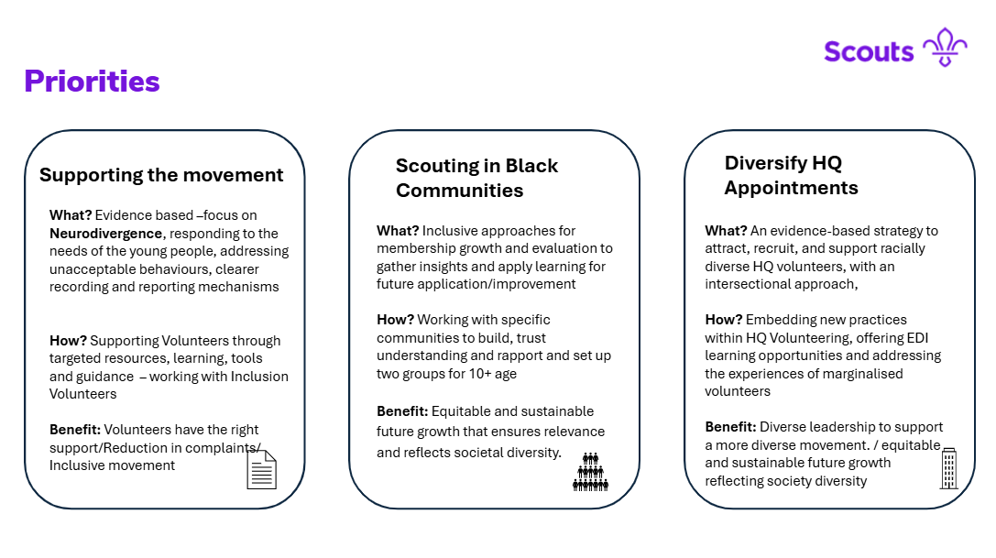

Slide 6
Things we have learned from the Consultation:
We're not as diverse as we would like to be- especially in our leadership. However, we've improved, and there is a will to keep going.
Our volunteers are finding increasing numbers of neurodiverse young people in their sections. They want to run inclusive Programmes.

Slide 7
Some people are not sure we are relevant but...
In a divided Country- we encourage tolerance, cohesion and build friendships across differences.
In a world where mental health feels fragile, and under threat, our programme gives young people the skills and experience to thrive

Slide 8
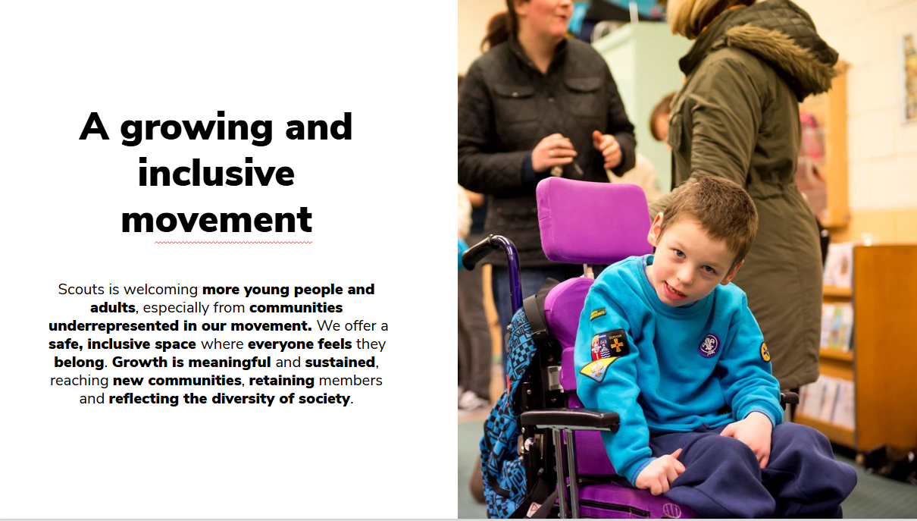

Slide 9
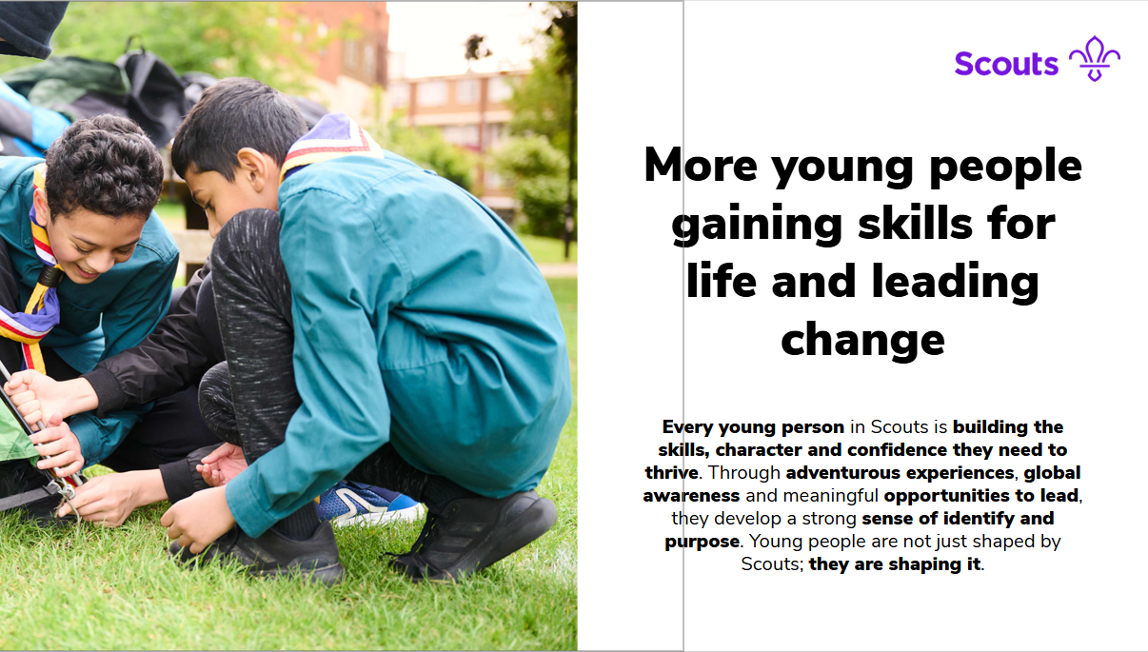

Slide 10
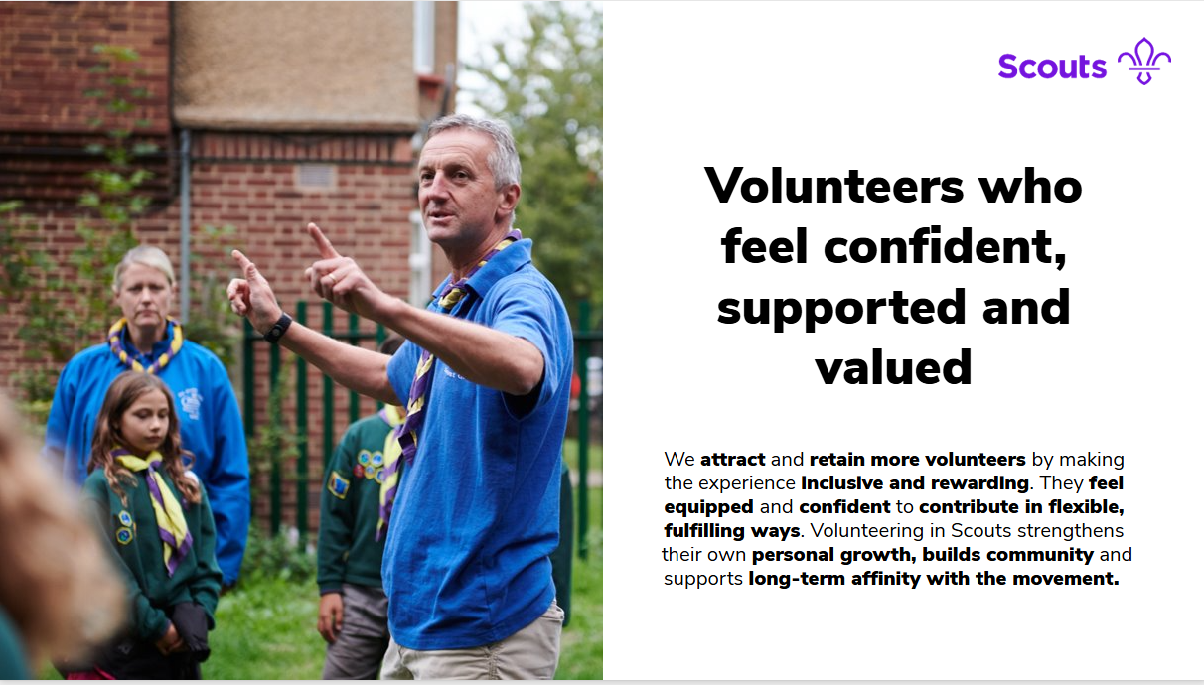

Slide 11
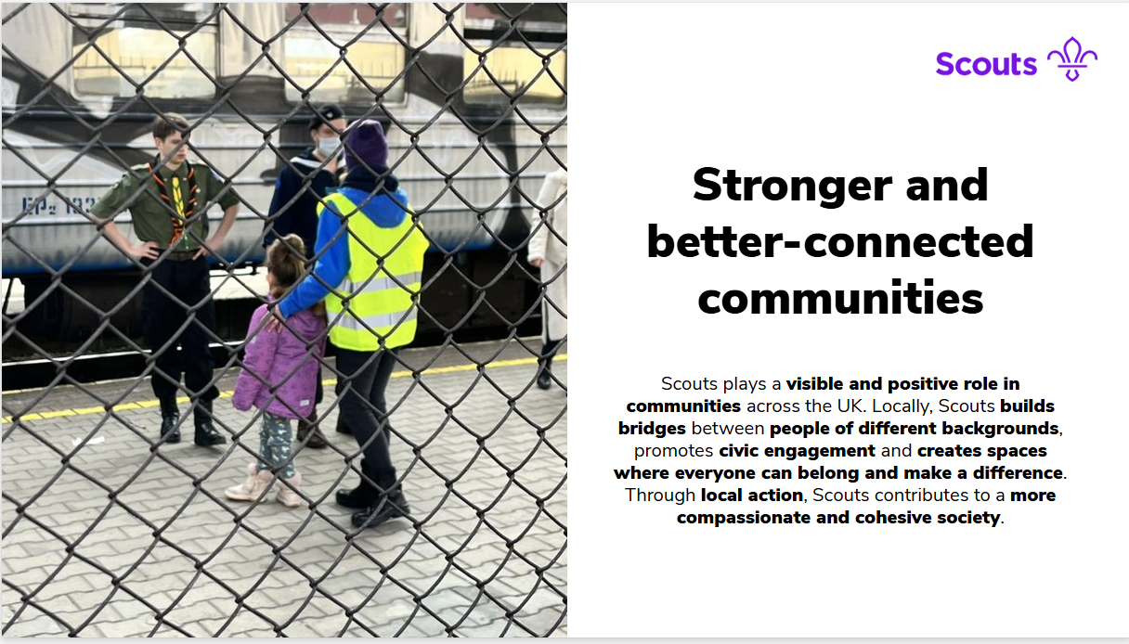

Slide 12
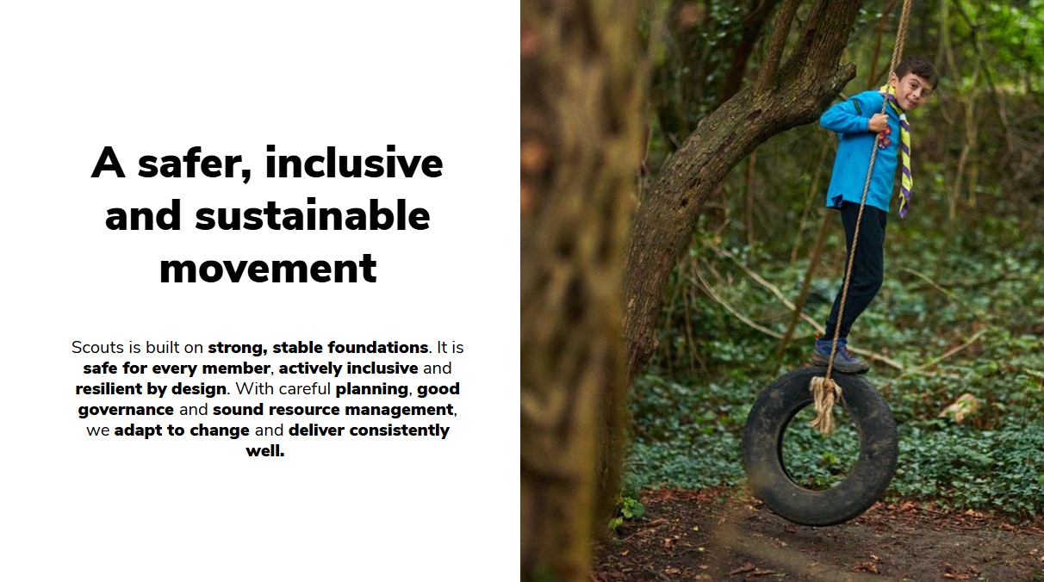

Slide 13
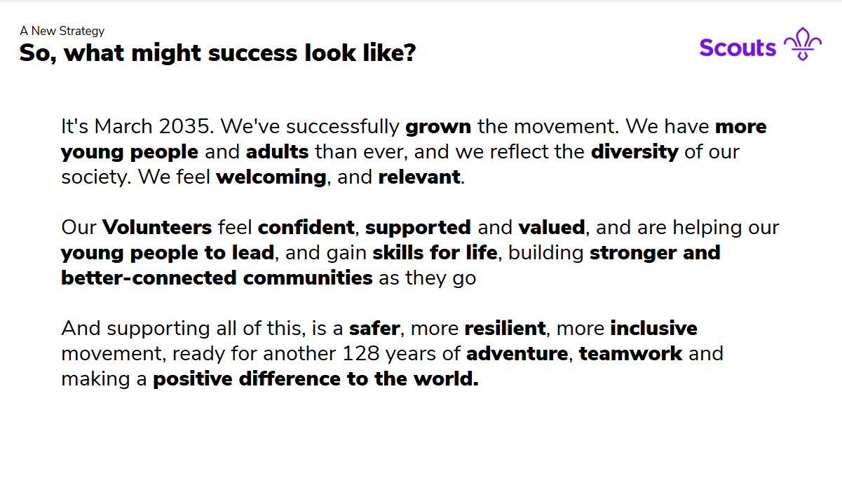

Slide 14
Equity, Diversity and Inclusion | Scouts

Slide 15
Thank you

