Slide 1
#SkillsForLife
County Vision & Opportunities

Slide 2
Northamptonshire is a top performer for Safety and Safeguarding compliance figures in the country.
Our suspensions over 60 days are zero.
However we do need your help on: -
First Response
Thank you
Notes:
Good morning and thank you for giving up yet more time to Scouting
FR Compliance – we have including new leaders around 400 people who need training
2025 offered 11 courses (1 cancelled) capacity pf 615 places and only had 294 attendees. There are courses available to book in Jan and Feb

Slide 3
County
Strategy
for 2026
Notes:
Why now? We had a Skills for Life Plan that was written in 2019 and was expected to last until 2023, this then got extended to 2025.
Was a total of 62 points many of which we achieved and lots that we didn’t, due to various reasons, COVID, transformation and even the fact that we changed CLV. It takes time to find your feet.
And with a National Strategy not quite ready (more about this later) I do not want to lose anymore years and therefore I have summarised into a few words what I feel passionately about even to this day after 45 years being invloved in the Scout movement

Slide 4
County Strategy
for 2026
A quality programme is the core of Scouting and to achieve this I believe the county should offer events to expand young people's Scouting experience while supporting volunteers to feel more confident in delivering their weekly scouting experience. In county facilities that reflect modern standards, while looking to the future by expanding our Scouting experience to new young people in the four to six bracket across the whole county.
Notes:
I will give you a minute to read this and then move on to explain how we, because without everyone in this room it can not be achieved, will use this until the national strategy is released in April (but lets say early summer) and then we as a County can formulate our County Strategy around this. How will we do this, likelihood is we will do as we have done previously in bringing together representatives from Groups, Districts and County to formulate our way forward. I want to achieve something we can all be vested in and here are the four areas I want us to concentrate on to start to achieve this

Slide 5
Quality County Events
Support Volunteers to feel confident in their role
Expand Squirrel Provision
SJLC Centre
County Strategy
for 2026
Notes:
I will now look to explain how I hope the county team is starting achieve this and can contnue to build upon what we have started

Slide 6

So far we have delivered
Squirrel Scrurry
Arran Adventure
Naseby 1645
Notes:
Here are some of the events we have delivered and play a couple of short videos to give you an idea of the scale of events we want to achieve

Slide 7


Slide 8
A quality programme is the core of Scouting and to achieve this I believe the county should offer events to expand young people's Scouting experience
County will hold events in the odd numbered years – 2027, 2029 etc
The aim is to provide opportunities that Groups and Districts may not be able to do.
Squirrel Activity Day 2027
Beaveree's 2026 & 2027
Cub Activity Day(s) 2026 & 2027
Scout 2027 - Overseas trip is planned for The Somme
Explorers 2027 Trip to Iceland – 2029 Return to Arran
A contingent to be sent to the WSJ in 2027
DofE Provision
BTEC – a chance to gain a qualification from Scouting skills
Car Fest 2026 and maybe even Naseby 2026 and beyond
County Events
Notes:
Great to see so many young and slightly older people have some fun. A quality programme is our aim, right from the smallest Drey night to the WSJ. Every programme, event has to be run to the best of our abilities, sometimes we wont always achieve it but lets give our leadership teams the tools to succeed.
Why odd numbered years? I feel it is important that Districts also get an opportunity to run their own large scale events for their young people, the aim of the County events is that they can be a bit bigger, or more specialist, or even just an opportunity for all our young people and adults to interact with others from other Districts. There has been some hiccups with dates prior to agreeing this policy which will see some overlaps in 2026 2027 but the aim going forward is very clear. Go through events and give a little about each
The aim through task based events is that teams come together, run an event and then disband. This way people do not feel they are stuck for ever or having to help on every event or even event they may not want to do.
BTEC Level 2 – Teamwork and Personal Development in the Community – also help DofE bronze and silver plus CSAs
The aim is to recruit enthuastic, passionate and people with the right skills for every event and provise even the smallest drey. Colony, pack, troop or unit the opportunity to join something bigger

Slide 9
while supporting volunteers to feel more confident in delivering their weekly scouting experience
Support Districts in providing Training Opportunities
Practical Training Weekends
Northants Reunion – an opportunity for an all adult event to network and pick up new skills.
Manager Training – supporting the new Regional course
FLP (Future Leaders Programme) iMOVEit
Supporting Volunteers
Notes:
The provision of training has changed from a County to District respomnsilibilty however the county will support as much as needed
The county is still hosting a centralised booking system
One idea floated at a meeting last week was a county based reunion style day/weekend where adults can network and learn, we will look to get this off the ground
Manager Training including Wood Badge is still ongoing with a completely rewritten course (piloting in the East Midlands) which covers all WB requirements plus additional skills needed for running Groups Districts etc.

Slide 10
In county facilities that reflect modern standards
The Trustee Board has agreed to underwrite the replacement of the Toilet Block from County funds.
The Centre Management Committee have been renewing equipment and adding new facilities
The success of SJLC is key to helping the County succeed
Sir John Lowther Centre

Slide 11
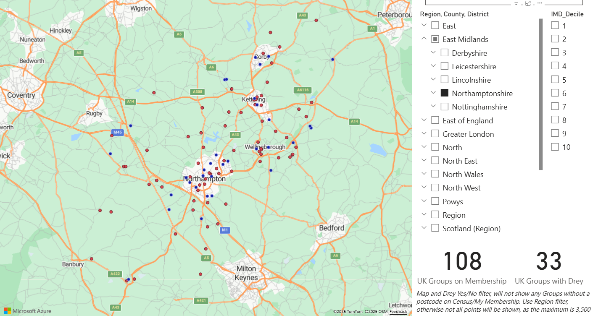
An aspiration
That almost every Group in Northamptonshire will have a drey by 2029
We have made good inroads so far with 33 Dreys out of a possible 108 Groups, we have also added good provision for other age ranges during the last year
You may ask why?
What can we do to help?
Dreys for 2029
while looking to the future by expanding our Scouting experience to new young people in thefour to six bracket across the whole county.​
Notes:
Why do we want squirrels , it encourages youyh membership from a younger age, allows us to get a new style of leader, squirrel leaders bring different skills to those of other sections. Experience shows us that we get clusters of new leaders mainly parents who then move the sections with their young people. We need to embrace this and realise that this is one of the new way forward in volunteering. Embrace the two years, there will be a constant stream of new recruits. We also find that sometimes their skills are better suited to other sections and they move.
The county is committed to new section grant (£250 matched funded by District) plus free membership for the first year

Slide 12
A quality programme is the core of Scouting and to achieve this I believe the county should offer events to expand young people's Scouting experience while supporting volunteers to feel more confident in delivering their weekly scouting experience. In county facilities that reflect modern standards, while looking to the future by expanding our Scouting experience to new young people in the four to six bracket across the whole county.
County Strategy
for 2026
Notes:
Just a reminder of what my aim is for 2026

Slide 13
Wanted
Section based Leaders – to join – Programme Team to help run events.
Compliance – person oe people to help us stay as one of the best
Car Fest 2026 – Team members to assist
Enthusiastic Adults who want to make a difference
Opportunities

Slide 14
Beyond Skills for Life:
The Scouts' Strategy (2026-2035)
Notes:
Here is a preview of the National Strategy, the core is written but some fine tuning is still going on
I am not going to spend long on this and will wizz through the slides

Slide 15
Vision:
To empower more young people, through adventure, teamwork, and shared values, to take the lead on making a positive difference in the world.
Purpose:
To actively engage and support young people in their personal development, empowering them to make a positive contribution to society.

Slide 16
The Two Core Pillars
Pillar 1: Delivering an Adventurous and Inclusive Programme (Focus on belonging, adventure, community, and the outdoors.)

Slide 17
Pillar 2:
Supporting Our Volunteers (Focus on attracting/retaining more volunteers who are well-trained, confident, and supported.)
Crucial Link: The pillars are inextricably linked and must be addressed simultaneously for success.

Slide 18
Strategic Outcomes (The 5 Milestones for 2035)

Slide 19
By 2035, The Scouts will have:
* A growing and inclusive movement (Reaching underrepresented communities, reflecting societal diversity).
* More young people gaining skills for life and leading change.
* Volunteers who feel confident, supported and valued.
* Stronger and better connected communities.
* A safe, inclusive and sustainable movement.

Slide 20
Focus of the First Three-Year Plan (2026-2029)

Slide 21
The first Plan is structured around three core Objectives:
* Objective 1: Programme (Safely deliver fun, relevant, and inclusive programme).
* Objective 2: Volunteering (Improve volunteering, ensuring people feel valued and supported).
* Objective 3: Enablement (To be a growing, sustainable, and effective movement).
Notes:
The strategy is delivered through a series of Three-Year Plans.

Slide 22
Summary of Programme Objectives
Key Focus: Updating educational objectives, refreshing section programmes, increasing Leader confidence (especially in neurodiversity, faiths/beliefs, ethnicity, socio-economic status), expanding outdoor/adventurous activities and nights away, growing youth voice/leadership, and embedding progressive resources on mental health/wellbeing, global engagement, and sustainability.

Slide 23
Summary of Volunteering Objectives
Key Focus: Improving volunteer support/management (complaints, problem-solving, suspensions), strengthening feedback and communication, realising the benefits of teams-based volunteering, reviewing Lead Volunteer roles for manageability, developing the learning framework (Branching Out), improving change management, and developing meaningful ways to thank and recognise volunteers (including newer members).

Slide 24
Key Focus: Mobilising resources for financial resilience, implementing a new membership growth strategy (informed by barriers/other organisations), embedding data-driven and equitable decision-making, strengthening staff/volunteer culture, enhancing safety processes and risk controls, maintaining a highly trusted brand (with a target of 50%+ approval among 25-44 year olds), and prioritizing environmental sustainability across the movement.

Slide 25
Strategy Development & Next Steps
Strategy developed from over 28,000 inputs since 2023. The plan will be presented to the UK Board of Trustees in October 2025. This first Plan (2026-2029) is the first step; progress will inform the Second Three-Year Plan (2029–2032).

Slide 26
Thank you for listening and happy to take any questions

